Slide 1
7: Popular Classification Models
CS 235

Slide 2
Classification Models Overview
Logistic Regression
Decision Trees
Random Forests
Support Vector Machines

Slide 3
Parameters vs Hyperparameters
Both are configuration variables
Parameters
Internal to the model (~ model parameters)
Learned or estimated during training
E.g. neural network weights
Hyperparameters
Control the learning process
Determine the values of model parameters
Chosen by user/developer
Used to train the model
Not part of the resulting model
E.g. learning rate in a neural network

Slide 4
Hyperparameter Tuning
Grid search
Sklearn.model_selection.GridSearchCV
SVM example
Random search
Sklearn.model_selection.RandomizedSearchCV
Uses distributions to guide the random search
SVM example
Halving
sklearn.model_selection.HalvingGridSearchCV
sklearn.model_selection.HalvingRandomSearchCV
param_grid = [ {'C': [1, 10, 100, 1000], 'kernel': ['linear']}, {'C': [1, 10, 100, 1000], 'gamma': [0.001, 0.0001], 'kernel': ['rbf']} ]
distributions = {'C': scipy.stats.expon(scale=100), 'gamma': scipy.stats.expon(scale=.1), 'kernel': ['rbf'], 'class_weight':['balanced', None]}

Slide 5
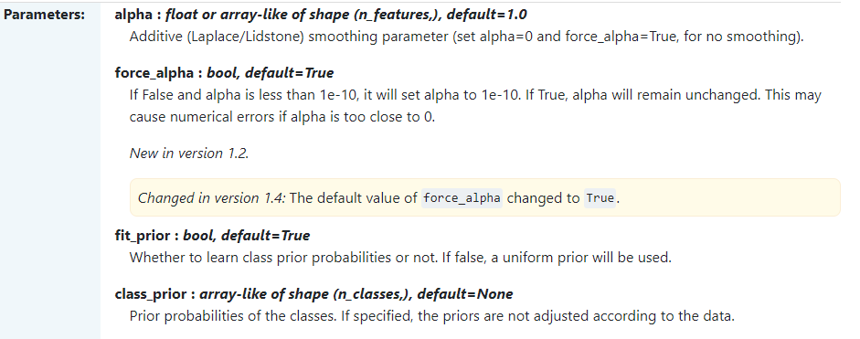
Naïve Bayes Hyperparameters?

Slide 6

Overfitting
Error rate in predicting the correct class for new cases
overfitting of test data
very low apparent error rate
high actual error rate

Slide 7
Logistic Regression

Slide 8
Linear Prediction and Logit Models
Y
LP Model
1
Logit Model
0
X

Slide 9
The logistic transformation
This is just the odds.
As the probability increases (from zero to 1), the odds increase from 0 to infinity.
So if β is ‘large’ then as X increases the log of the odds will increase steeply.
The log of the odds then increases from –infinity to +infinity
The steepness of the curve will therefore increase as β gets bigger

Slide 10
Fitting the model
Maximum Likelihood Estimation
Probability of observing the particular set of dependent variable values
Find the coefficient values (α, β) that makes the observed data most likely
Iterative process
Try different models (~ α, β parameters in the equation)
Until “line” fit no longer improves = “best fit”
Solves {Y - π(Y=1)}X_{i} = 0 summed over all observations, i = 1,…,n

Slide 11
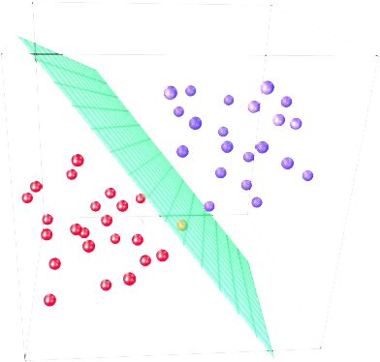
Logistic Regression
Y_{i} ∊ {0, 1}; X can be anything numeric.
We’re learning a linear
separating hyperplane, but fitting it to a logit outcome

Slide 12
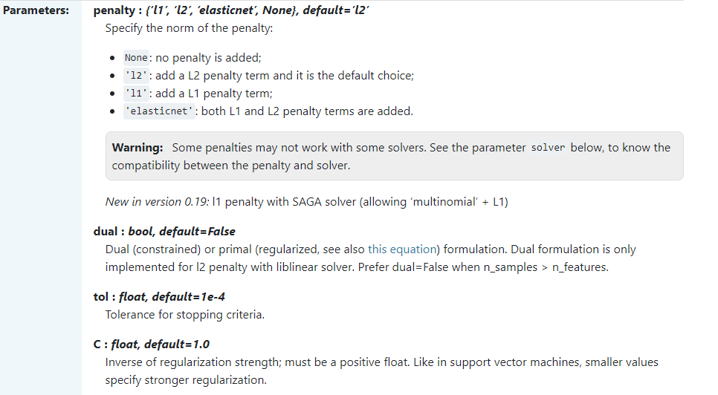
What hyperparameters are there?

Slide 13
SVMs

Slide 14
Support Vector Machines
The line that maximizes the minimum margin is a good bet.
The model class of “hyper-planes with a margin of m” has a low VC dimension if m is big.
This maximum-margin separator is determined by a subset of the datapoints.
Datapoints in this subset are called “support vectors”
It will be useful computationally if only a small fraction of the datapoints are support vectors, because we use the support vectors to decide which side of the separator a test case is on
The support vectors are indicated by the circles around them.

Slide 15
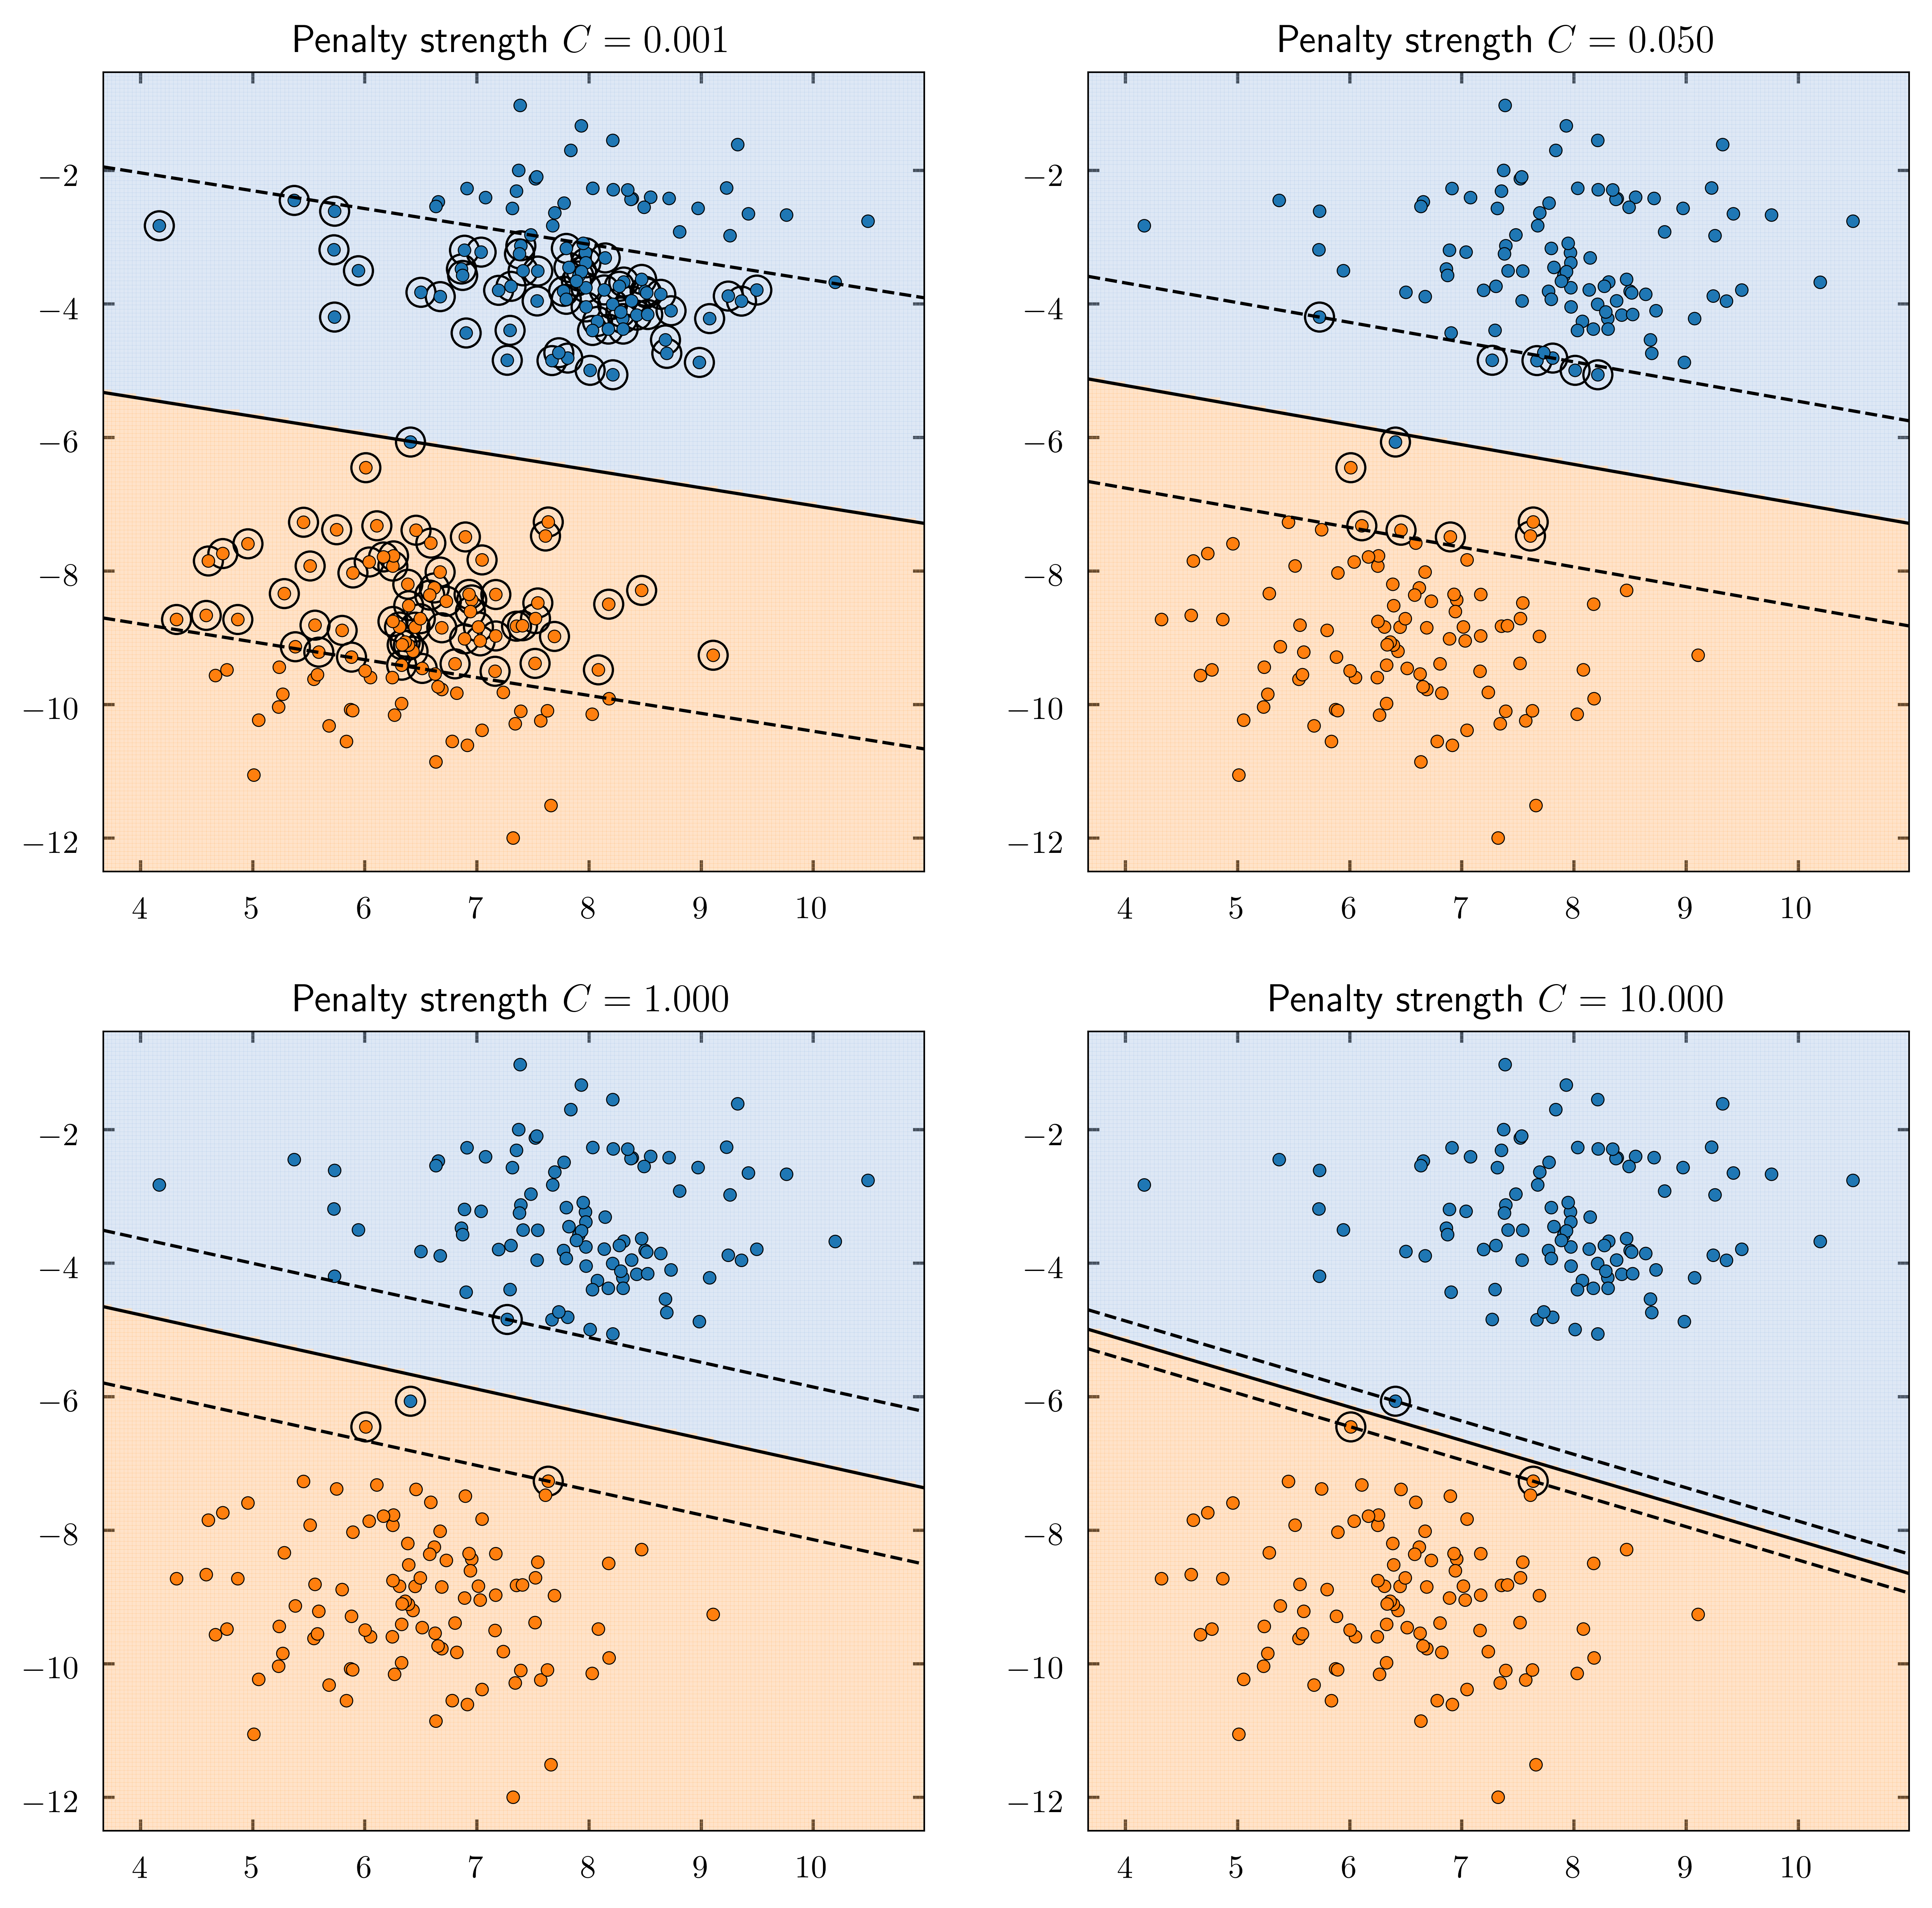
Slack variables
certain training points will be allowed to be within the margin
constrained to be non-negative
allows us to “cheat” by putting the plane closer to the datapoint than the margin
minimize the amount of cheating?
pick a value for λ (Lambda)
C = penalty strength
C = 1/ λ
Smaller λ usually means higher chance of overfitting

Slide 16
The kernel trick
Low-D
Mapping a low-D space to a high-D space
operation on two vectors in the low-D space
used to compute the scalar product of their two images in the high-D space
High-D
Letting the kernel do the work
doing the scalar product

Slide 17
The classification rule
The final classification rule is quite simple:
Model training:
Select the right kernel function
Model then selects the support vectors that maximize the margin and compute the weight to use on each support vector
The set of support vectors

Slide 18
Performance
Support Vector Machines work well in practice
Hyperparameters
Kernel function
Parameters for the specific kernel function
Expensive for big datasets
The computation of the maximum-margin hyper-plane depends on the square of the number of training cases
We need to store all the support vectors
SVM’s work well if you have no idea about what structure to impose on the task

Slide 19
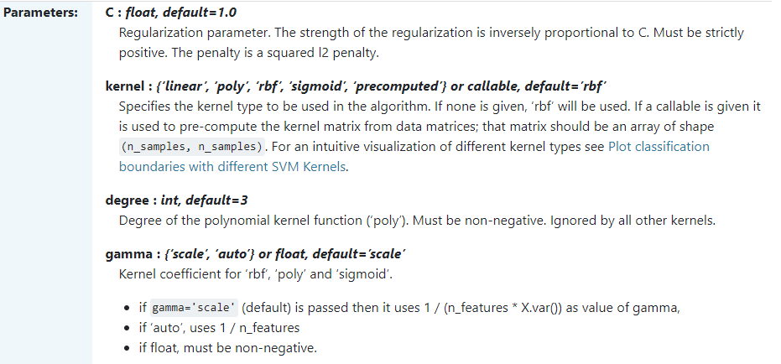
What hyperparameters are there?

Slide 20
Decision Trees

Slide 21
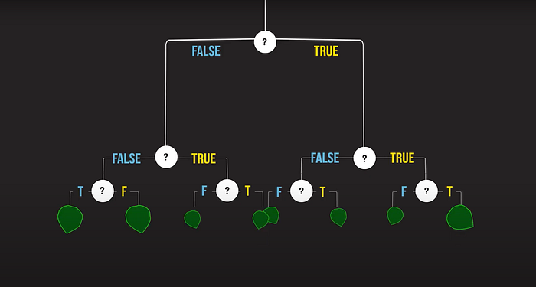
Decision Tree

Slide 22
General Idea
Decision rules - partition sample of data
Terminal node (leaf) indicates the class assignment
Tree partitions samples into mutually exclusive groups
One group for each terminal node
All paths
start at the root node
end at a leaf
Each path represents a decision rule
joining (AND) of all the tests along that path
separate paths that result in the same class are disjunctions (ORs)
All paths - mutually exclusive
for any one case - only one path will be followed
false decisions on the left branch
true decisions on the right branch

Slide 23
Goal
Develop tree that
is small
classifies and predicts class with accuracy
Small size
a smaller tree more easily understood
smaller tree less susceptible to overfitting
large tree less information regarding classifying and predicting cases

Slide 24
Rule Learning
Process of building the decision tree
Decision tree algorithms
induce decision trees recursively
from the root (top) down - greedy approach
established basic algorithms include ID3 and C4.5

Slide 25
Infuence of Attribute Types
Continuous variables attributes - problems for decision trees
increase computational complexity of the task
promote prediction inaccuracy
lead to overfitting of data
Convert continuous variables into discrete intervals
“greater than or equal to” and “less than”
optimal solution for conversion
difficult to determine discrete intervals ideal size and number
What kind of vectorization makes sense?

Slide 26
Splitting on the Data
Models induce a tree by recursively selecting and subdividing attributes
random selection - noisy variables
inefficient production of inaccurate trees
Efficient models
examine each variable
determine which will improve accuracy of entire tree
problem - this approach decides best split without considering subsequent splits
Use INFORMATION measures

Slide 27
Information Measures for Splitting the Tree
Goal: determine which variable would split the data such that the underlying child nodes are “pure”
Entropy and Information Gain
= measure of uncertainty
The average level of information of a variable’s possible outcomes
Value between
0 = all instances in one class
1 = perfectly even split between leaf nodes
Information gain = Entropy_parent – AVG(Entropy_children)
Gini Index
Probability for a random point to be misclassified
Lower Gini index = lower probability of missclassification

Slide 28
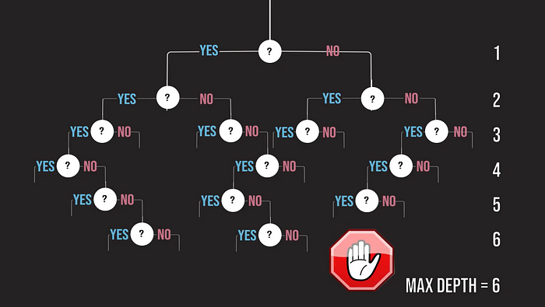
Max Depth
Why would we want to limit depth?
Notes:
reduce the capacity of these trees by restricting the number of splits i.e. limiting the depth of the trees

Slide 29
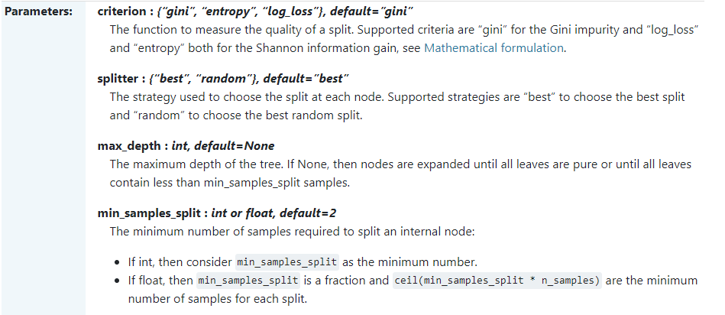
What hyperparameters are there?

Slide 30
Random Forest

Slide 31
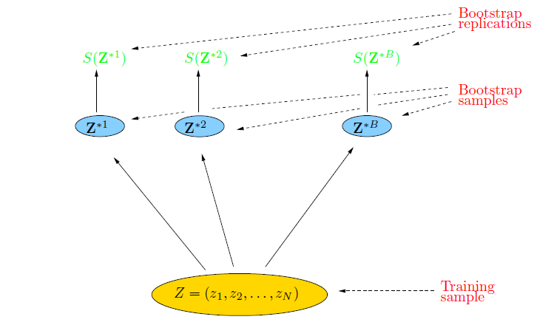
Ensemble methods
Bootstrapping
randomly draw datasets with replacement from the
training data, each sample the same size as the original training set
Bagging
bootstrap aggregation
reduces the variance of an estimated prediction
Random Forest
Ensemble of decision trees
A committee of trees each cast a vote for the predicted class

Slide 32
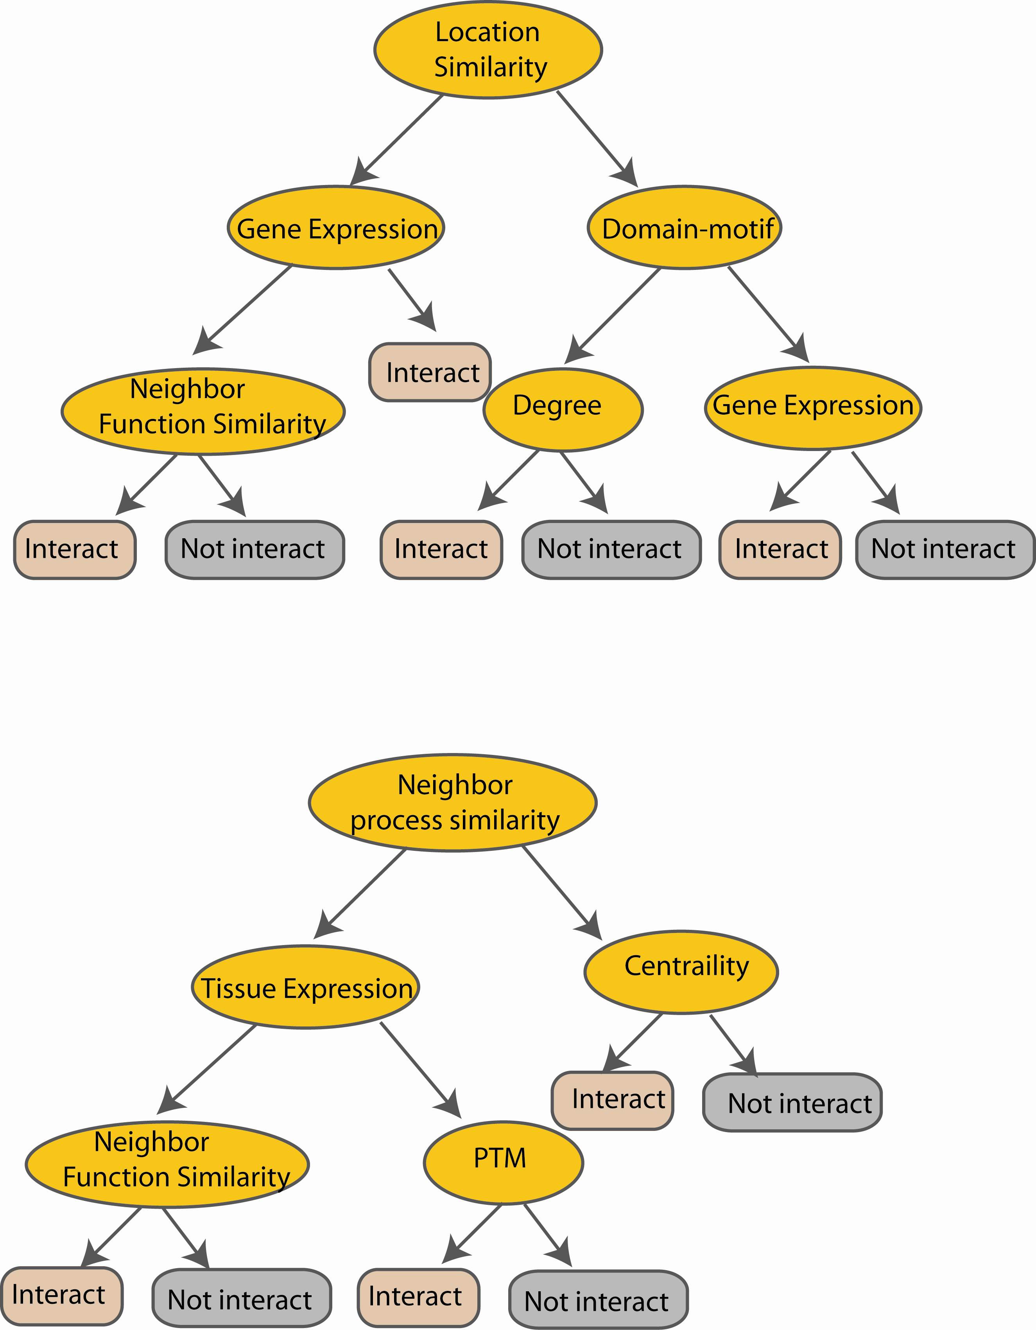
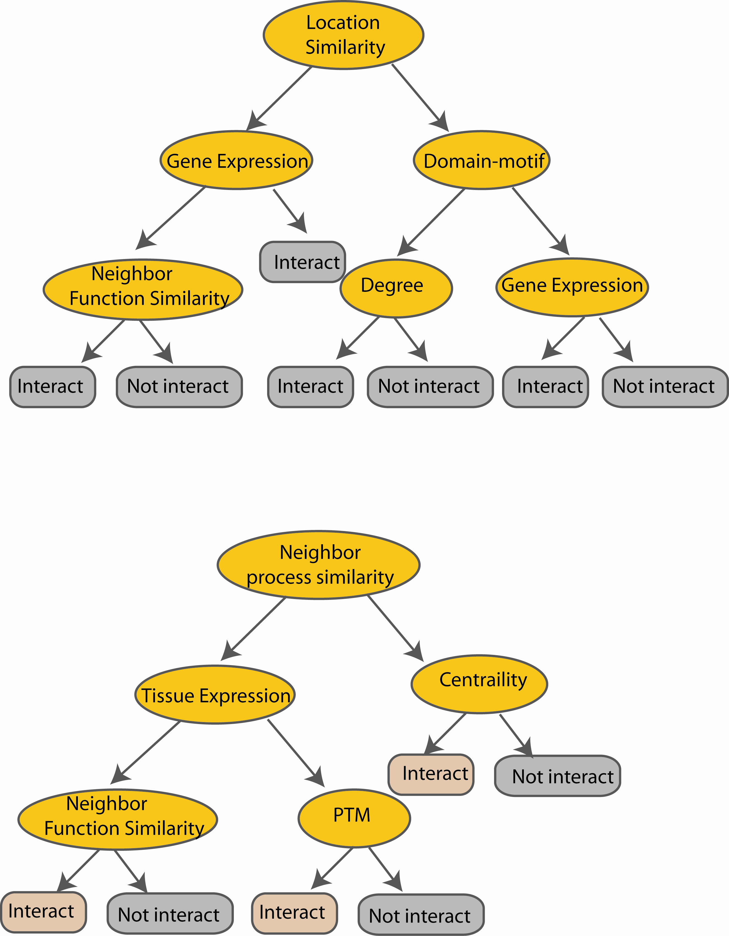
Random Forest Classifier
Create decision tree
from each bootstrap sample
M features
N examples
Take the majority vote
....…
....…
Notes:
Finally the given an input data the decision is made as follows given an input data,

Slide 33
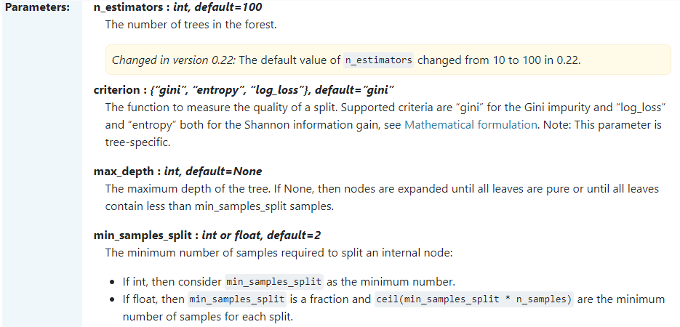
What hyperparameters are there?

